Slide 1
Mathematics for data scientists Esoph data set
KIESGEN de RICHTER Stanislas
Vaio Luca

Slide 2
Presentation of the data set

Slide 3
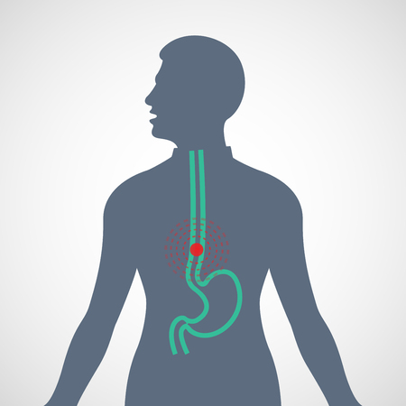
Origin of the data
Study of esophageal cancer in Ille-et-Vilaine, France.
Based on three criteria:
Age group
Tabaco consumption per day
Alcohol consumption per day

Slide 4
How is the data organised
Age group | Alcohol consumption (g/day) | Tobacco consumption (g/day) | Number of cases | Number of controls
25-34 | 0-39g/day | 0-9g/day | 0 | 40
35-44 | 0-39g/day | 10-19g/day | 1 | 14
45-54 | 80-119g/day | 30+ | 2 | 4

Slide 5
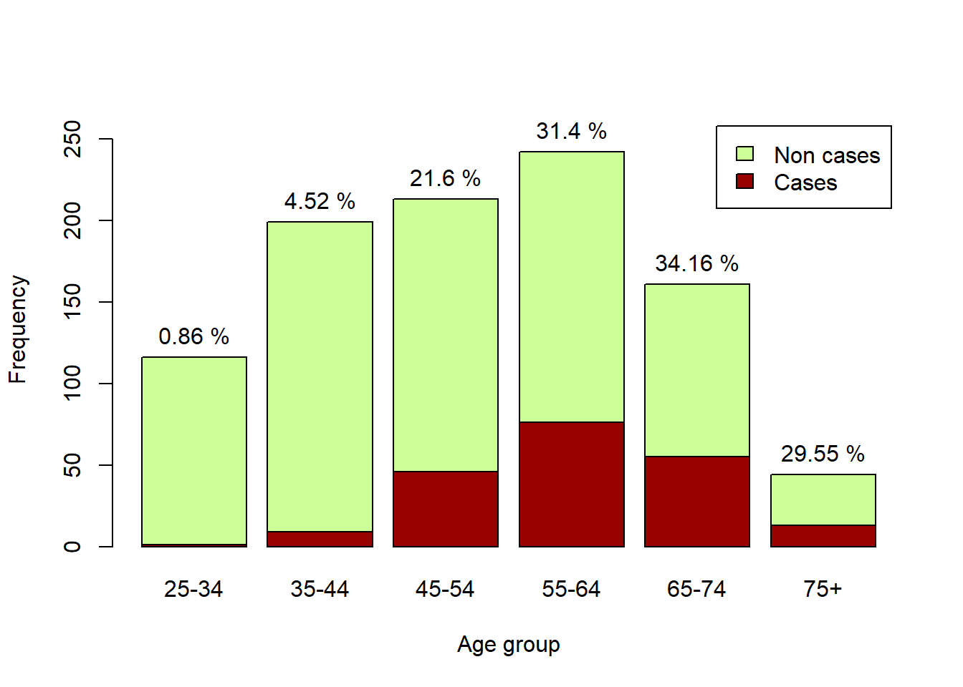
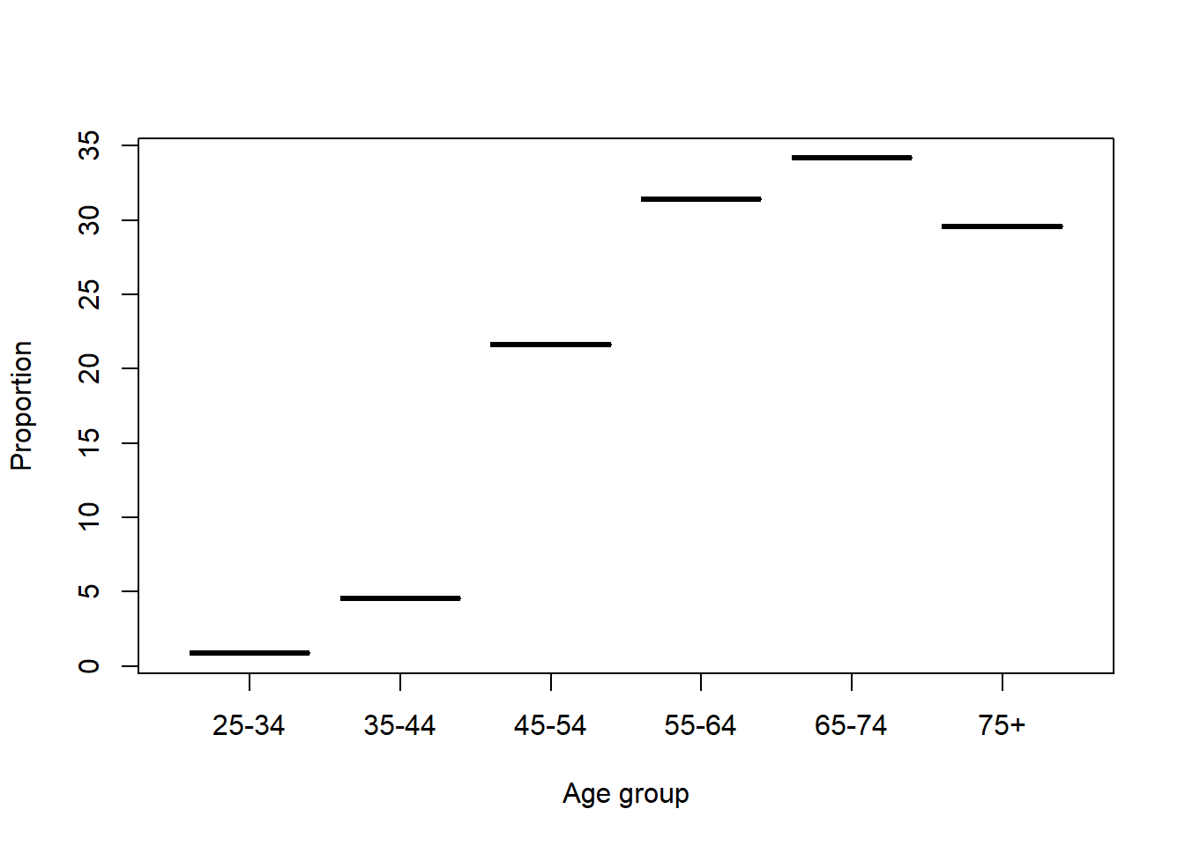
Cases per Age Group

Slide 6
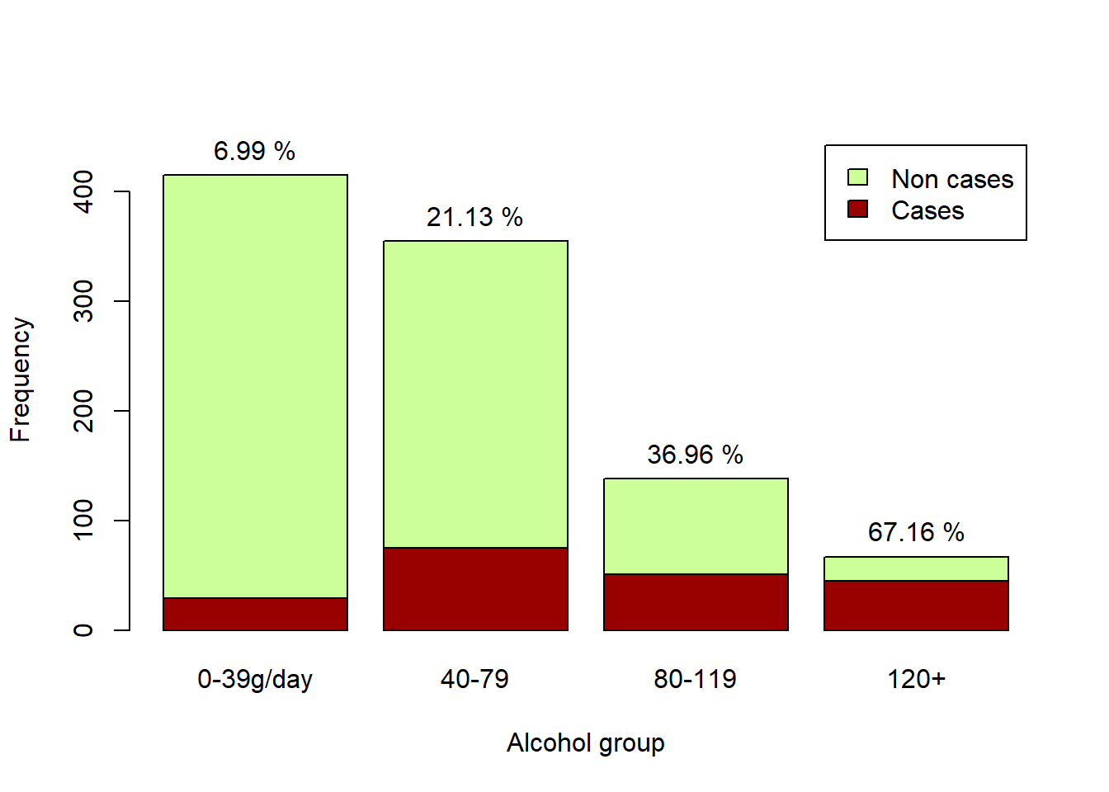
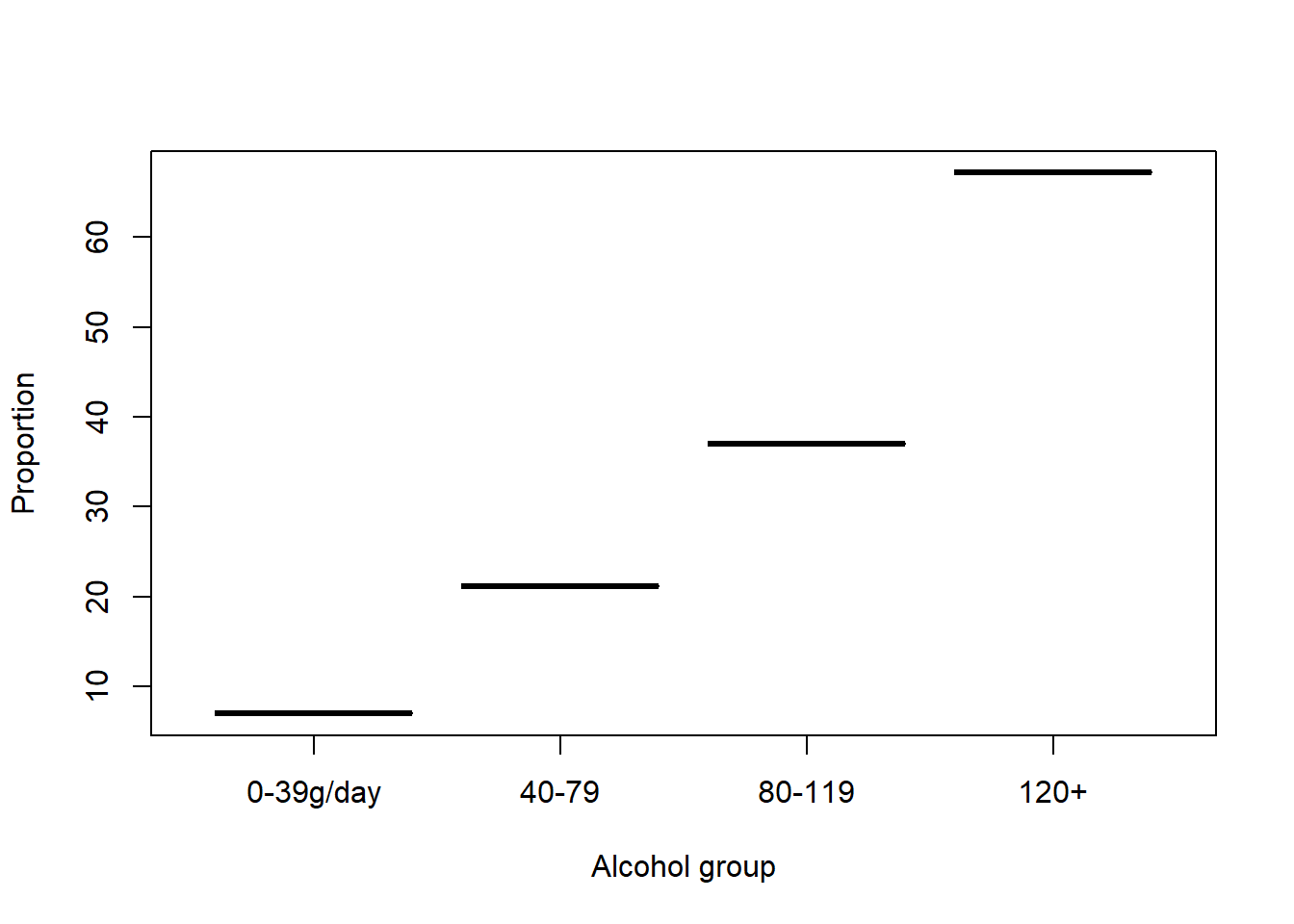
Cases per Alcohol Group

Slide 7
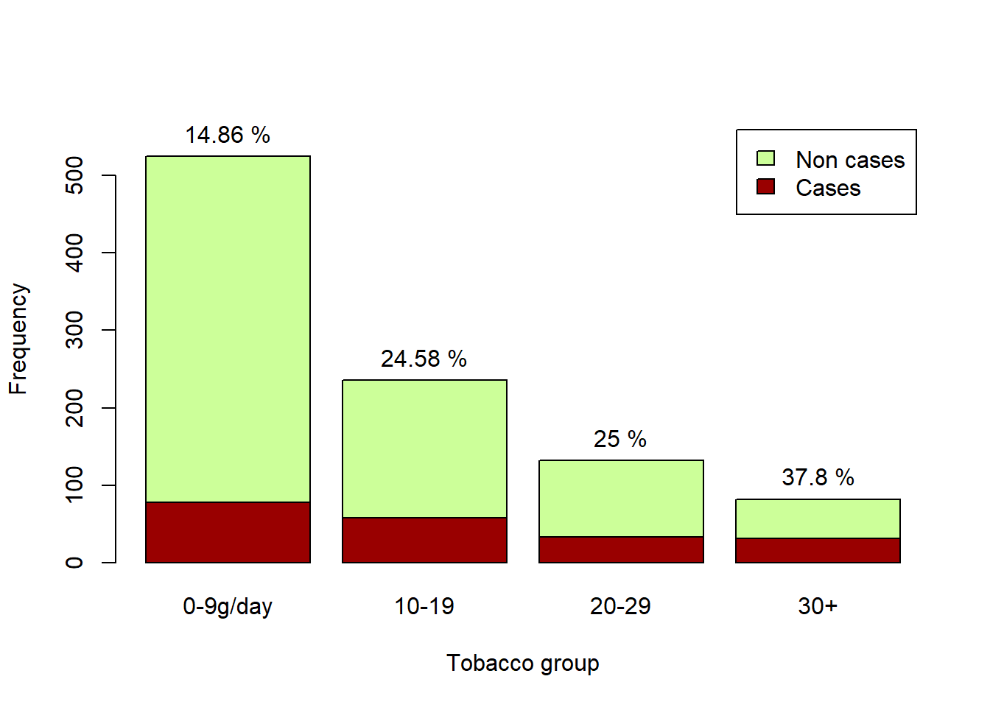
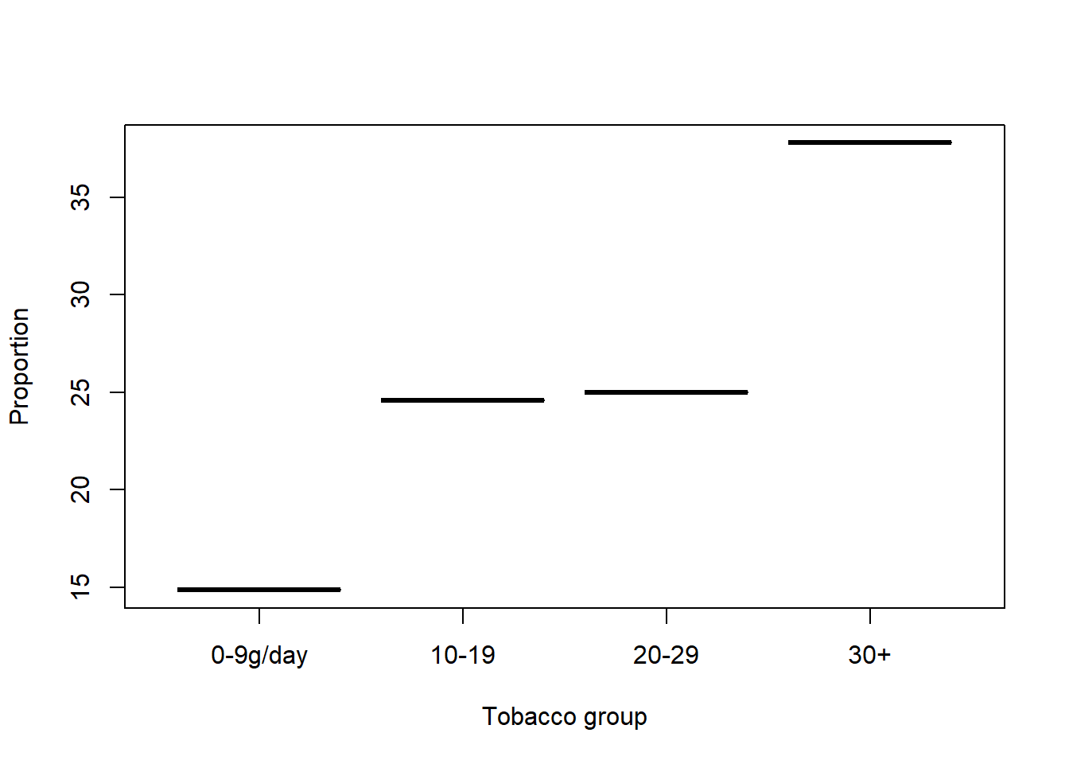
Cases per Tobacco Group

Slide 8
Hypothesis

Slide 9
Smoking and cancers correlation
H0: Tobacco and cases are independent
Ha: They are correlated
P-value = 0.0003702 <<< 0.05 Threshold H0 is rejected the value are correlated
Smoking and cancers are correlated
Tobgp | Ncases | ncontrols
0-9g/day | 78 | 525
10-19g/day | 58 | 236
20-29g/day | 33 | 132
30+g/day | 31 | 82

Slide 10
Age and cancers correlation

Slide 11
Model building

